Slide 1
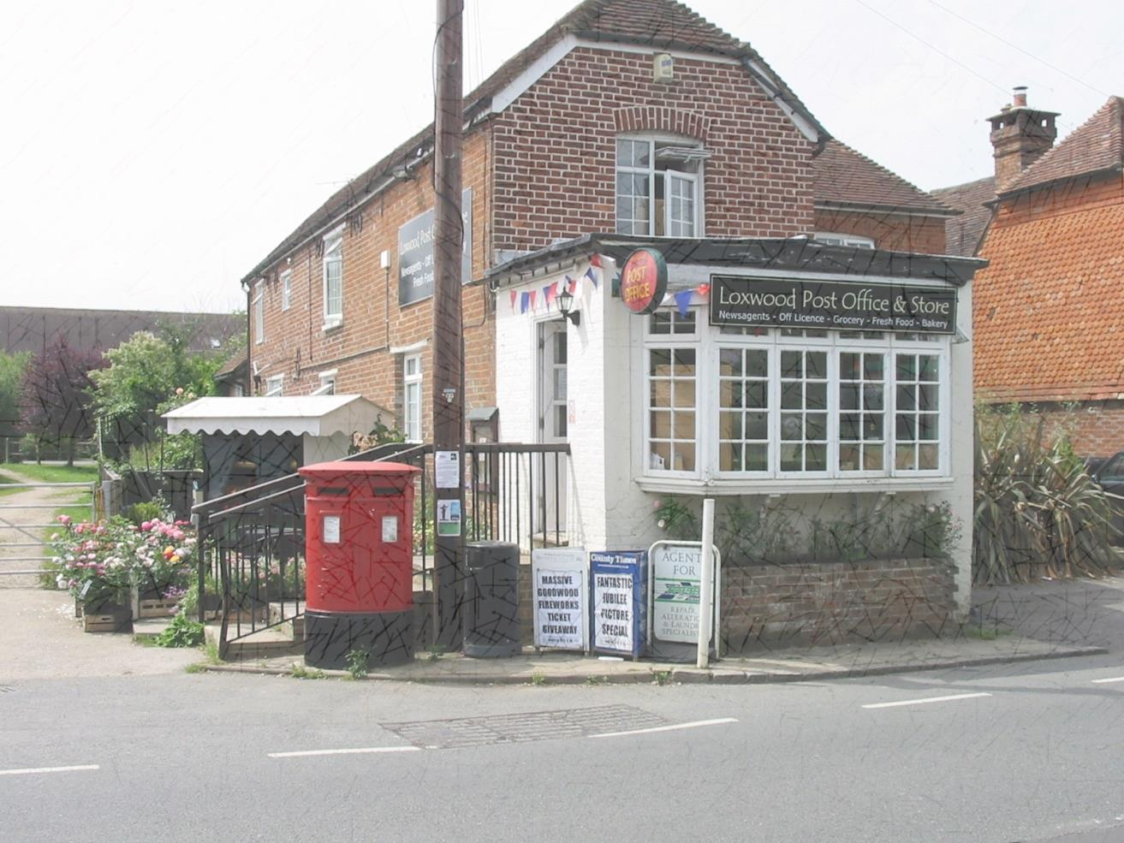
Loxwood Parish Council
Public Meeting
Sunday 9th December 2018
Chichester District Council’s proposals for additional housing in Loxwood

Slide 2
AGENDA
Chairman’s opening comments
Presentation by Cllr. Tony Colling
Public questions.
Public vote on updating Neighbourhood Plan.
Presentation on how to comment on Local Plan.
Further questions

Slide 3
Chairman’s Introduction
Why are we all here? – you may well ask!
Chichester District Council (CDC) and Loxwood implemented their Local and Neighbourhood Plans on 14th July 2015
CDC’s Local Plan was subject to a review after 5 years due to a known shortfall in housing numbers
CDC now about to publish its revised preferred draft Local Plan for the period 2016 -2035 for public consultation

Slide 4
Chairman’s Introduction –contd.
CDC have increased their total housing requirement by 40%
Loxwood will be expected to provide an additional 125 houses over and above the 60 required in the previous made Local Plan
That makes a total of 185 new houses for Loxwood!
This is a disproportionate allocation compared to the other Service Villages in the North of Plan Area which have either zero or 25 only for Wisborough Green
The impact this has for Loxwood is significant and Loxwood Parish Council needs your support for the decisions it must take
Tony Colling will now take us through the background, legislation and implications for us all

Slide 5
Loxwood Parish Council
Housing-1
CDC are producing a new Local Plan
Public Enquiry inspector required CDC to review existing Plan after 5 years
UK needs to build 250,000 -300,000 new houses/year to meet growing and changing population
Councils have undershot this need for many years thus a national shortage of housing
Government drive now to build more using carrot and stick approach
Government has developed a common methodology for calculating each district councils housing need – the OAN or Objectively Assessed Need
In the past each council used its own methodology to calculate OAN resulting in large variations - district to district

Slide 6
Loxwood Parish Council
Housing -2
CDC have used the new government OAN methodology to calculate new housing requirement
Result is an increase of 40% on last Local Plan numbers
Old Plan - 434 houses per year i.e. a total of 7,388 houses -2012 to 2029
New Plan (on CDC website) - 651 houses per year i.e. a total of 12,478 houses - 2016 to 2035
Parish of Loxwood is allocated 125 new houses
This is on top of existing Neighbourhood Plan requirement of 60 houses
This means a minimum of 185 houses on allocated sites but with a potential to exceed 200 houses with windfall additions of less than 6 houses in a development

Slide 7
Loxwood Parish Council
Housing - 3
In it’s Spatial Vision for North of the District, CDC states that:-
“Loxwood will develop its role as a larger village with development potential. In other villages, some limited development will take place”
Kirdford and Plastow/Ifold allocated zero and Wisborough Green - 25 houses
this was 60, 10 and 60 respectively in old Local Plan
CDC’s strategy was to issue a “call for sites” which resulted in their Housing and Economic Land Availability Assessment (HELAA) (See next slide)
Within Loxwood 5 sites have been identified by developers or landowners as being available for development
No sites were put forward in Kirford and Plastow/Ifold and only one in Wisborough Green

Slide 8
HELAA for Loxwood Village

Slide 9
Loxwood Parish Council
Housing - 4
CDC accepted all sites put forward and allocated housing numbers accordingly - therefore planning is developer led
The Sites in Loxwood are all in the village which currently has 450 houses
This gives a housing increase in the village of 45 % over the 20 year period
LPC have met with CDC to protest about the housing allocation for Loxwood and its apparent unfairness but our arguments “fell on deaf ears”
CDC are driven to get the draft Local Plan completed and maintain a 5 year housing supply

Slide 10
Loxwood Parish Council
Loxwood Neighbourhood Plan-1
Current NP allocated 60 houses on two sites
Nursery Site 43 and Farm Close 17 houses
Plan has 18 policies
The question is “What should we do about the Neighbourhood Plan going forward”?
CDC’s new Local Plan is timetabled to be “Made” by 2020
As the CDC plan becomes more mature, the housing policies in the Neighbourhood Plan becomes less substantive
Loxwood then becomes vulnerable to uncontrolled developer led development
Policies in the NP such as Vernacular, Street Lighting etc. remain valid for the duration of the current plan
So we will have a weakening Neighbourhood Plan going forward
LPC would still receive 25% of Community Infrastructure Levy (CIL) for the duration of the current plan
Without an Neighbourhood Plan parish receive 15% of the CIL

Slide 11
Loxwood Parish Council
Loxwood Neighbourhood Plan-2
CDC have stated that if we choose not to update Neighbourhood Plan they will allocate sites for development
LPC recommends that we start the process of updating the Neighbourhood Plan immediately
It is better that the parish controls where the development should be and not developers and/or CDC
It will be more straight forward than last time and we will have about 18 to 24 months to complete the process
We will have to allocate sites to accommodate a further 125 houses although this number may change during the public consultation phase and the Public Enquiry conducted by a government inspector
The Nursery and Farm Close sites would remain the same as NP policies

Slide 12
Loxwood Parish Council
Loxwood Neighbourhood Plan-3
The first phase of the new Local Plan public consultation starts on the 13 December and runs to the 7 February 2019
LPC would encourage all residents to comment on the Plan using the CDC web portal or by direct e mail to CDC planning
We will discuss this in part 2 of the presentation
Questions so far and then we will have a show of hands on whether or not to update the Neighbourhood Plan

Slide 13
Loxwood Parish Council
Part 2- Consultation (1)
There will be 2 consultations on the draft Local Plan
Phase 1- 13 December 2018 to 7 February 2019
Phase 2- dates unknown, but will be after all comments have been reviewed by CDC and the Plan amended if deemed necessary by CDC
Phase 2 consultation will be on the final version of the plan which will be submitted to a public enquiry
All comments on the final version of the plan will be submitted to the inspector running the public enquiry
LPC will publish on its web site how to comment on the Plan together with the dates
LPC have resolved to object to the Draft Local Plan based on a number of issues to do with sustainability, process and fairness
LPC letter of objection will also be on the PC website which residents can use to comment of the draft Local Plan

Slide 14
Loxwood Parish Council
Part 2- Settlement Hierarchy
Settlement Type | Communities
Sub Regional Centre | Chichester City
Settlement Hubs | East Wittering/ Bracklesham, Selsey, Southbourne, Tangmere
Service Villages | Birdham, Bosham, Boxgrove, Camelsdale / Hammer, Fishbourne, Hambrook / Nutbourne, Hermitage, Hunston, Kirdford, Loxwood, North Mundham / Runcton, Plaistow / Ifold, Stockbridge, West Wittering, Westbourne, Westhampnett, Wisborough Green.
Rest of Plan Area | Small villages, hamlets, scattered development and countryside

Slide 15
Loxwood Parish Council
Part 2- Parish Housing Requirements
Parish | Housing Figure | Parish | Housing Figure
Birdham Chichester City Itchenor Funtington Lavant North Mundham Plaistow & Ifold West Wittering Westbourne Total 500 | 125 50 0 0 0 50 0 25 0 | Boxgrove Earnley Kirdford Loxwood Lynchmere Siddlesham Westhampnett Wisborough Green | 50 0 0 125 0 0 50 25

Slide 16
Loxwood Parish Council
Part 2- Sustainable Development in Loxwood
The NPPF part 2 requires that Local Plans and planning applications deliver sustainable development
Para 4 of the draft Local plan also seeks to deliver sustainable development
Elements of sustainability as defined in the Draft Local Plan are:-
The pattern of need and demand for housing and employment across the area;
Infrastructure capacity and constraints, in particular relating to wastewater treatment,
Roads and transport;
Environmental constraints – avoiding flood risk areas, protecting the environment
Designations, landscape quality, the historic environment and settlement character;
The availability of potential housing sites, their deliverability and phasing

Slide 17
Loxwood Parish Council
Waste Water Infrastructure Issues in Loxwood
Southern Water have declared the sewage network to be “at capacity” and that no new connections can be made without mitigation to improve the system due to surface water inundation
The funding mechanism for achieving such improvements changed in April 2018 to the benefit of developers
The Nursery site has been required to provide 2 sewerage holding tanks with a discharge valve controlled by a sensor to control discharge to the network when the system has capacity
This is deemed by CDC to be a temporary solution until Southern Water upgrade the system
However, Southern water have no plans to upgrade the system for the for the foreseeable future within their forward spending plans

Slide 18
Loxwood Parish Council
Employment, Schools and Transport
No major employment exists in Loxwood thus residents are required to commute
Loxwood School going forward would not be able to accommodate children from an additional 200 plus houses
Loxwood has no sustainable public transport links, which the Draft Local Plan acknowledges!
Nearest Railway stations are Billingshurst, Guildford or Horsham
Loxwood medical centre could prove to be inadequate for an additional 200 houses worth of residents
Conclusion
The Draft Local Plan housing provision for Loxwood does not meet the test for Sustainability and thus can be considered to be unsound
Questions?

